Slide 1
Coursera Capstone IBM Applied Data Science Capstone “The Battle of Neighbourhoods” Finding a Neighbourhood for an Indian family to settle down in Queens, New York
By :Abhinav Yadav
Notes:
1

Slide 2
Introduction
The United States of America is the country with one of the largest immigrant population in the world. After the IT boom , this immigration in recent times has been driven by IT workers from Asia coming into the states. Indians flock by the 1000's to America chasing the American Dream. New York has one of the largest Indian population . Out of all the Boroughs - Queens with 6.2 % Percent of Indian Americans in Municipality Population seems to be one that has welcomed the India community with open arms and is a popular location for Indians to settle down.
In this project we will try to find an optimal location for an India family to settle. Specifically, this report will be targeted to people interested in settling down in Queens , New York, USA.
Since there are lots of Neighbourhoods in Queens we will try and find a location that has :
1- Schools 2- Parks 3- Doctor's Office 4- Indian restaurant
Notes:
2

Slide 3
Problem Statement
The objective of this capstone project will be to find a suitable neighbourhood for an Indian family with kids to settle down .This would be done by leveraging Data Science and Machine Learning (k - means). The main Business question that will be answered in the Capstone Project will be : “Which neighbourhoods in Queens New York are best suitable for an Indian Family with kids to settle down in ?”
Notes:
3

Slide 4
Stakeholders/Target Audience
The Capstone Project will be particularly useful for people looking to move into new towns, cities or even countries. The project can also be modified to go beyond the current scope as it can be used to scope out other businesses in the area be it gyms , schools etc . The project can be used in an advisory capability by property consultants, realtors etc who can use the project to give their customer an overview of the area and allow them to make a better informed decision. With basic knowledge, customers themselves can use this project to better understand the option available with them to make informed decisions
Notes:
4

Slide 5
Data
Data used in this project is the New York dataset and was sourced from: https://cf-courses-data.s3.us.cloud-object-storage.appdomain.cloud/IBMDeveloperSkillsNetwork-DS0701EN-SkillsNetwork/labs/newyork_data.json
The coordinates of places if and when required can be sought by using geopy. Geopy is a Python client for several popular geocoding web services. Geopy makes it easy for Python developers to locate the coordinates of addresses, cities, countries, and landmarks across the globe using third-party geocoders and other data sources
Finally Foursquare API will be used for identifying and analysing areas of interests which basically involves using the API to gather the following details –
Number of venues in a particular area based on the radius provided by the user based on neighbourhood details.
Name of the venue
Category of venues (Schools , Parks etc )
Location of the Venue
Notes:
5

Slide 6
Methodology
Data Collection
Exploring the neighbourhoods using Foursqaure API
Clustering the Data using K - means Algorithm
Visualization of the clusters using Folium Library
Analysing the results to find the best neighbourhood for settling down
Methodology explained in detail in the report
Notes:
6

Slide 7
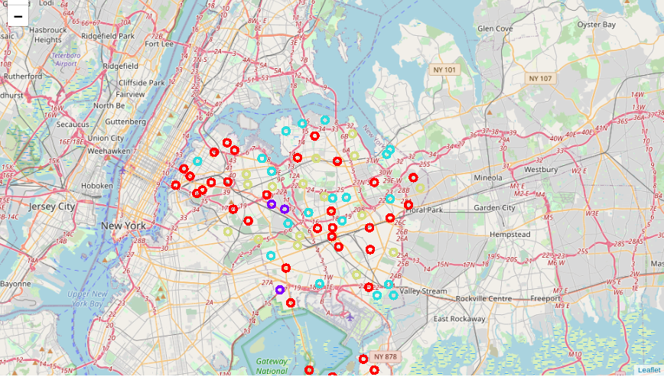
Results & Conclusion
Map of Queens after running k-means , dividing Queens neighbourhoods
into 3 clusters
Notes:
7

Slide 8
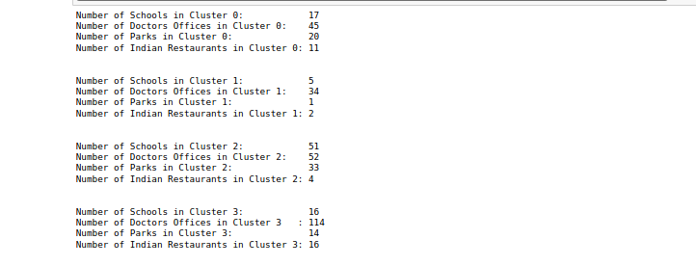
We now take at the results of the clusters which were the output of the k – Means algorithm
We can see from the results above that cluster 2 with the best mix of our priorities is best suited for a family to settle down.
Notes:
8

Slide 9
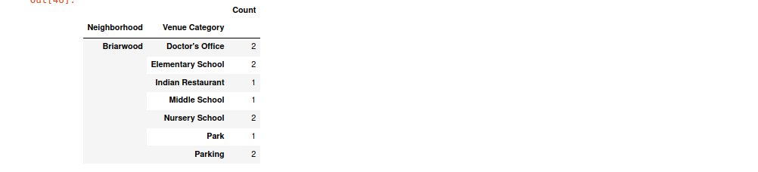
After Exploring Cluster 2 further we realise that the Neighbourhood of Briarwood is best suited for living for our new family. Briarwood has Elementary, Middle School, Doctors Offices, Parks and Indian restaurant which satisfies all conditions that we started out when looking for a neighbourhood.
Notes:
9

Slide 10
Conclusion
This project while looking very simple utilises the power of data and more so machine learning to provide an in depth look into the neighbourhoods in our desired Geographical area .The project has ended up answering the problem statement we started out with and the answer was the neighbourhood of Briarwood. An informed decision can be taken after analysis done through the project. The icing on the cake as far as the project goes is that the project is easily modifiable as per the whims and fancies of user which enhances its usability under different conditions.
Notes:
10

Slide 11
Thank You !!!
Notes:
11

